Slide 1
Travelling Salesman Problem: Convergence Properties of Optimization Algorithms
Group 2
Zachary Estrada
Chandini Jain
Jonathan Lai

Slide 2
Introduction
B
F
A
C
E
D
Travelling Salesman Problem
Surface Reconstruction
Marcus Peinado and Thomas Lengauer. `go with the winners' generators with applications to molecular modeling. RANDOM, pages 135{149, 1997.

Slide 3
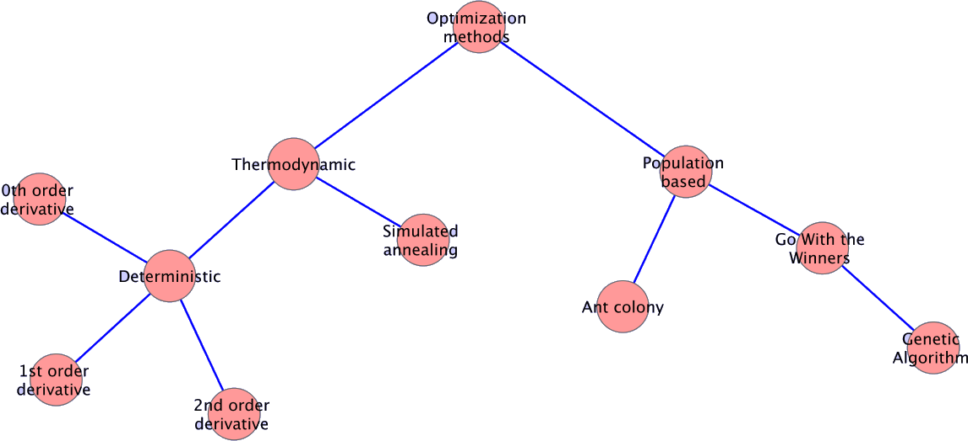
Hierarchy of Optimization Methods

Slide 4
Hamiltonian Description
Penalizes vertices with connections unequal to required connection
Where,
r_{i} is the position of particle_{i}
V_{k} is the number of vertices particle_{i} is connected to
V₀ is the actual number of vertices particle_{i} should be connected to
k_{b} = 1, bond constant
k_{v} = 1024, vertex constant

Slide 5
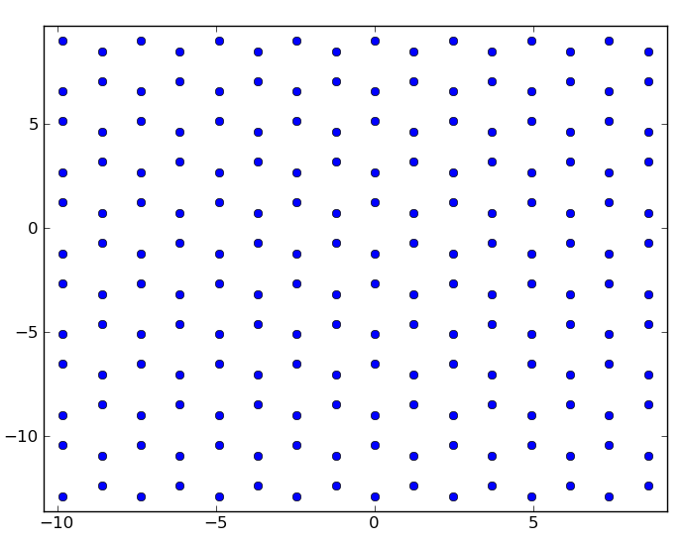
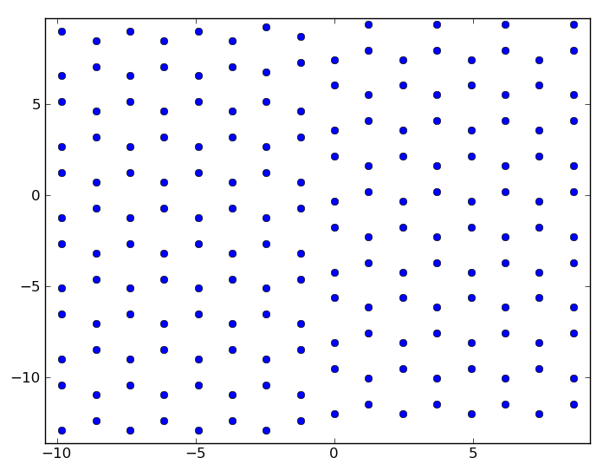
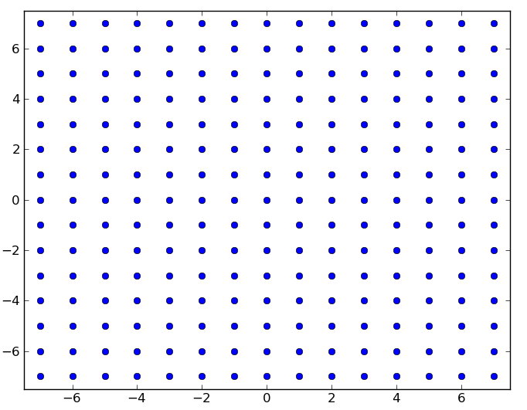
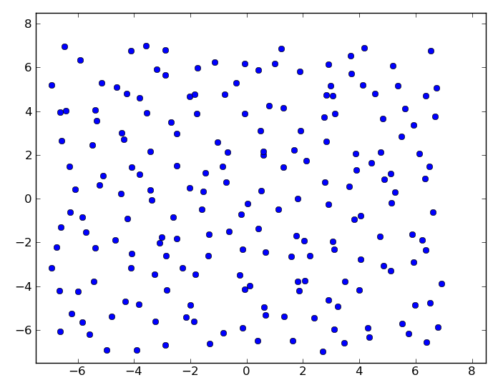
Test Systems
Honeycomb Lattice
Sheared
Honeycomb Lattice
Square Lattice
Square Lattice –
Random Positions

Slide 6
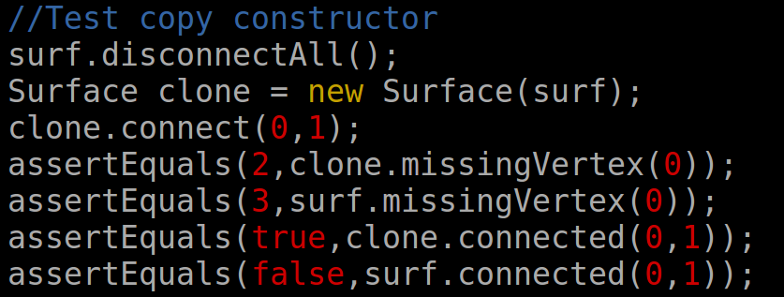
Code Implementation
Java – Heavylifting
Cross-Platform
Abstraction
TDD - JUnit
Threads
Python – Analysis
Tcl (VMD) – Analysis
Awk – Input File

Slide 7
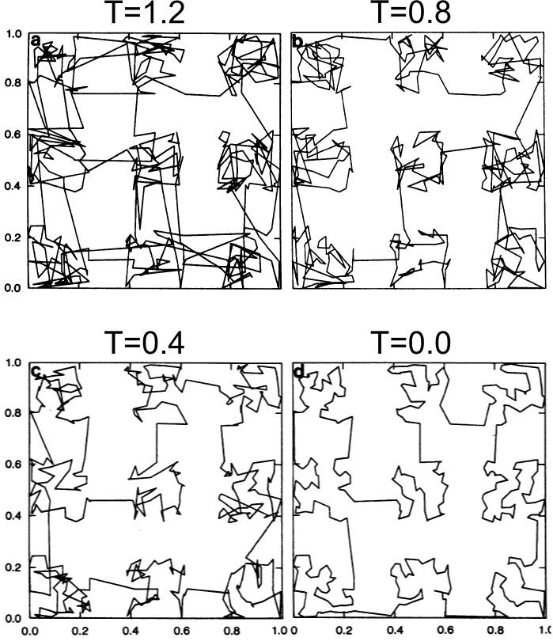
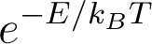
Simulated Annealing: Controlled Cooling
"Optimization by Simulated Annealing" S. Kirkpatrick, C. D. Gelatt, Jr., and M. P. Vecchi, Science 13 May 1983: 220 (4598), 671-680.

Slide 8

Simulated Annealing Moves
http://mathbits.com/mathbits/studentresources/graphpaper/graphpaper.htm

Slide 9
Simulated Annealing Moves
http://mathbits.com/mathbits/studentresources/graphpaper/graphpaper.htm

Slide 10
Simulated Annealing Moves
http://mathbits.com/mathbits/studentresources/graphpaper/graphpaper.htm

Slide 11
Simulated Annealing Moves
http://mathbits.com/mathbits/studentresources/graphpaper/graphpaper.htm

Slide 12
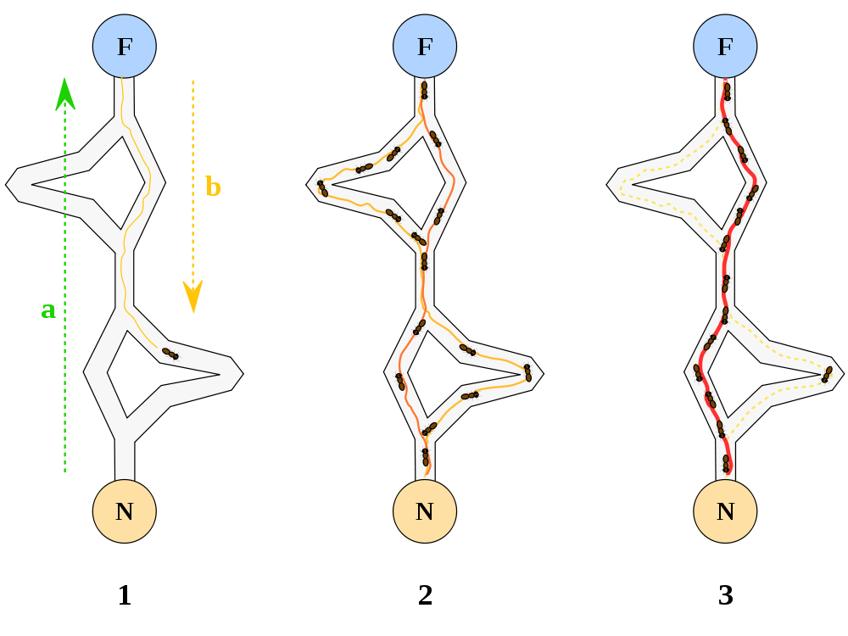
Ant Colony
http://en.wikipedia.org/wiki/File:Aco_branches.svg

Slide 13
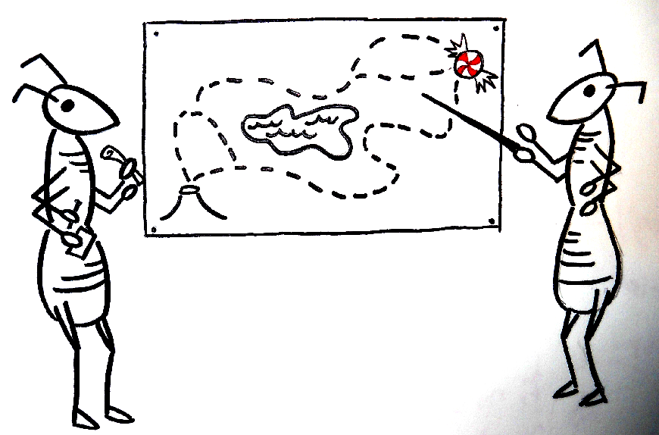
Ant Colony - Implementation
Pheromone Matrix
Each Ant Constructs a Solution
Update Pheromone Matrix

Slide 14
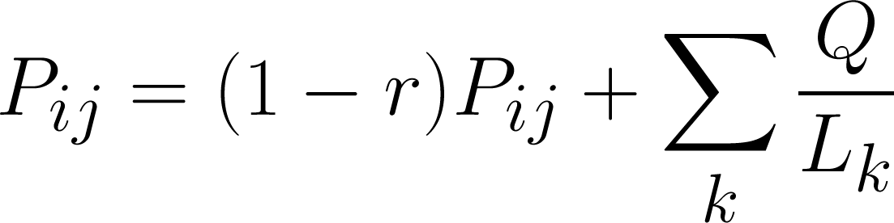
Ant Colony – Implementation (contd..)
Update pheromones based on energy

Slide 15
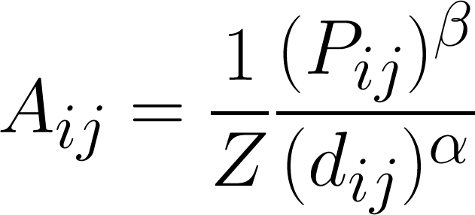
Ant Colony – Implementation (contd..)
Update pheromones based on energy:
Accept moves during walk with probability:

Slide 16
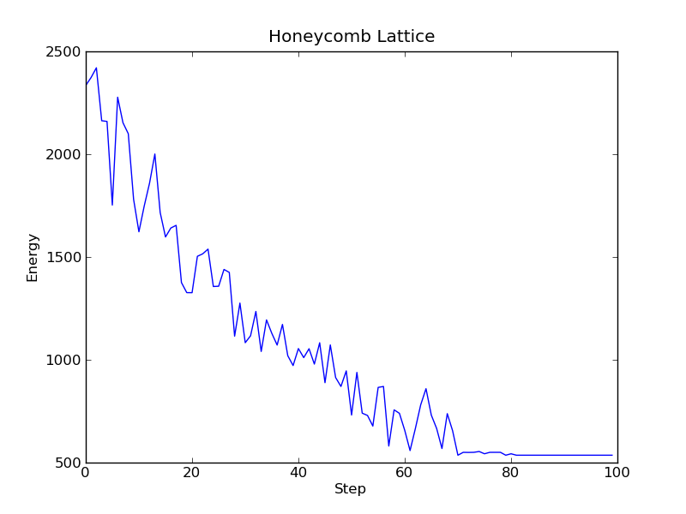
Ant Colony – Discussion

Slide 17
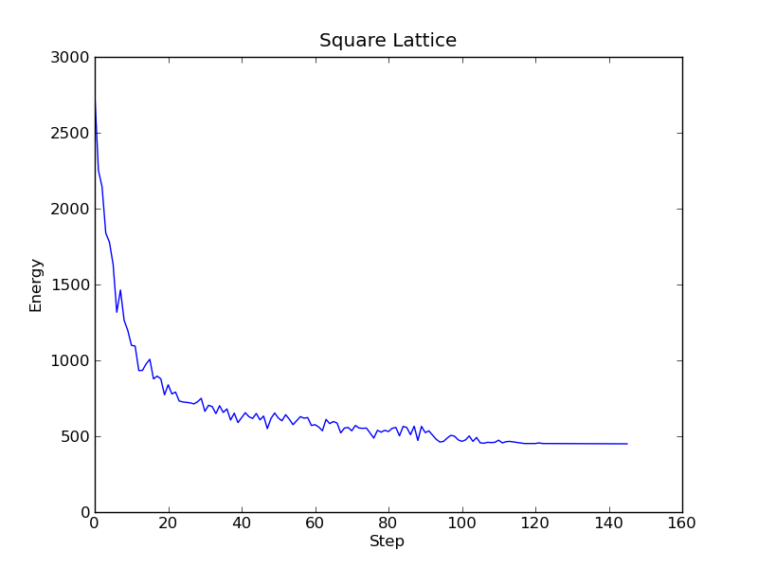
Ant Colony – Discussion

Slide 18
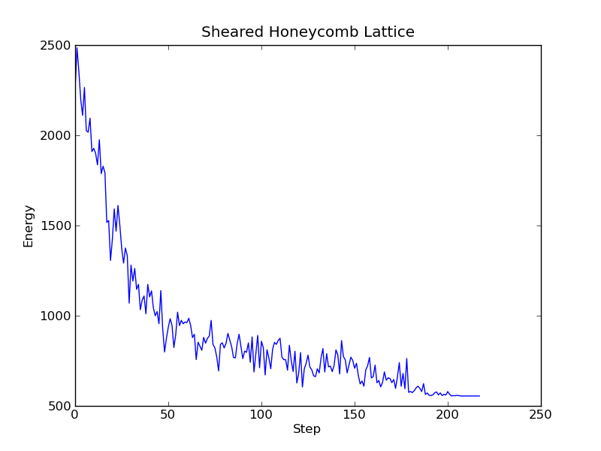
Ant Colony – Discussion

Slide 19
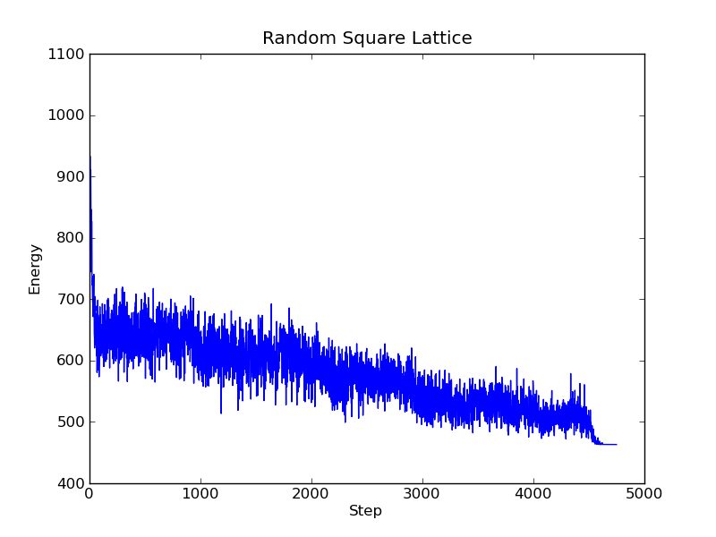
Ant Colony – Discussion

Slide 20
Genetic Algorithms: Survival of the Fittest
Generate an initial random population
1 | 1 | 0 | 1 | 1
1 | 0 | 0 | 0 | 1
0 | 1 | 0 | 0 | 1
0 | 1 | 1 | 1 | 0
Evaluate fitness of individuals
Select parents for crossover based on fitness
Introduce children into the population and replace individuals with least fitness
1 | 1 | 0 | 1 | 1
1 | 0 | 0 | 0 | 1
Perform crossover to produce children
1 | 1 | 0 | 0 | 1
1 | 0 | 0 | 1 | 1
1 | 0 | 1 | 1 | 1
Mutate randomly selected children
“A genetic algorithm tutorial”, Darrell Whitley , Statistics and Computing, Volume 4, Number 2, 65-85, DOI: 10.1007/BF00175354

Slide 21
Genetic Algorithm: Generation Rules
Selection - Fitness proportionate/roulette-wheel selection:
Area of the wheel assigned to each parent in proportion to fitness
Crossover - Matrix Crossover Variant:
Select a column M at random and interchange column data between parents
After interchange, V_{k}> V₀ for any particle, disconnect from farthest neighbor
Mutation - 2-Opt Operator Variant:
Connect all particles between two randomly chosen points i₁ and i₂ with a randomly chosen neighbor
After interchange, V_{k}> V₀ for any particle, disconnect from farthest neighbor

Slide 22
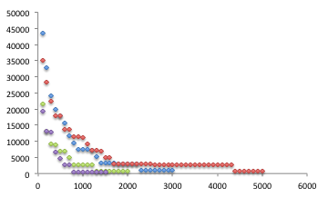
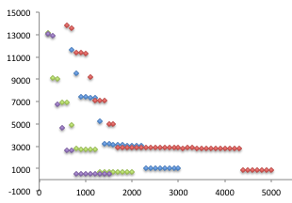
Genetic Algorithm: Energy v/s Iterations
Mutation
Crossover
Hexagonal Lattice

Slide 23
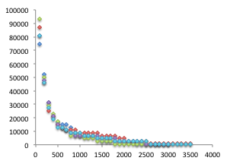
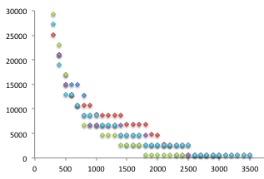
Genetic Algorithm: Energy v/s Iterations
Mutation
Crossover
Sheared Hexagonal Lattice

Slide 24
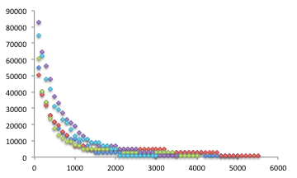
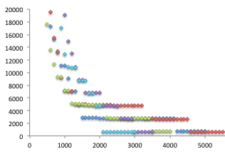
Genetic Algorithm: Energy v/s Iterations
Mutation
Crossover
Square Lattice – Random Positions

Slide 25
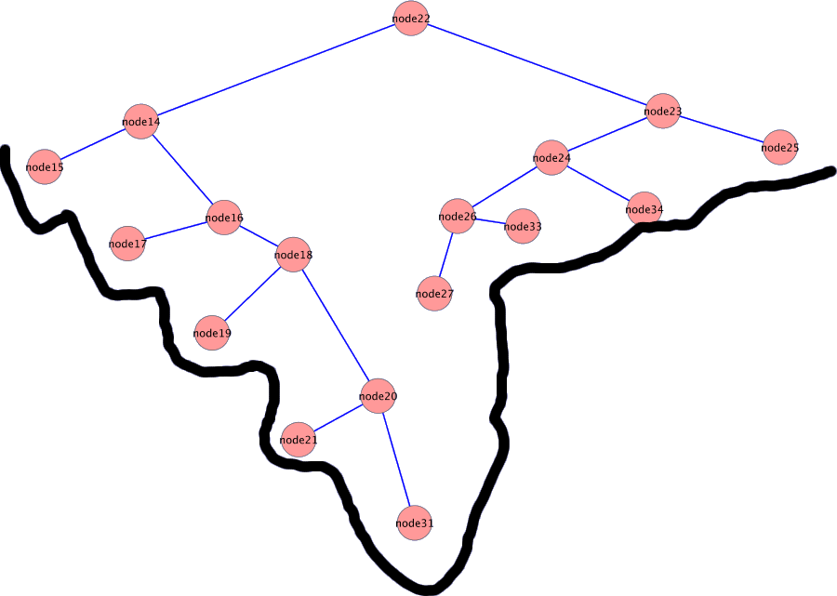
Go With The Winners

Slide 26
Go With The Winners
GWTW – Simulated Annealing with survival of fittest
Moves are predetermined
Create/destroy bonds
Swap bonds to explore phase space faster
Survival of the fittest
Select single winner of system
Kill off lower half of population
Repopulate single winner clone

Slide 27
Honeycomb Lattice: Comparison
Best Solutions
All Algorithms
 | Simulated Annealing | Ant Colony Optimization | Genetic Algorithm | Go With the Winner
Avg Energy | 535.967999 | 535.967999 | 703.6449 | 535.967999
Best Energy | 535.967999 | 535.967999 | 535.967999 | 535.967999
Avg Run Time (s) | 797 | 9 | 113 | 1422
Avg Iterations | 800000 | 94 | 2800 | 400000

Slide 28
Square Lattice: Comparison
Best Solutions
Simulated Annealing
Other Algorithms
 | Simulated Annealing | Ant Colony Optimization | Genetic Algorithm | Go With the Winner
Avg Energy | 1277 | 450 | 450 | 1518
Best Energy | 1277 | 450 | 450 | 450
Avg Run Time (s) | 1093 | 24 | 113 | 1713
Avg Iterations | 800000 | 128 | 2800 | 400000

Slide 29
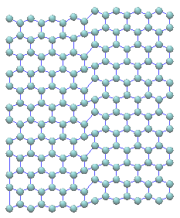
Sheared Hexagonal Lattice: Comparison
Best Solutions
Ant Colony Optimization
Genetic Algorithm
Go With the Winner
 | Ant Colony Optimization | Genetic Algorithm | Go With the Winner
Avg Energy | 554.928 | 606.89764 | 962.64
Best Energy | 554.928 | 554.928 | 962.64
Avg Run Time (s) | 4 | 155 | 940
Avg Iterations | 243 | 3100 | 400000

Slide 30
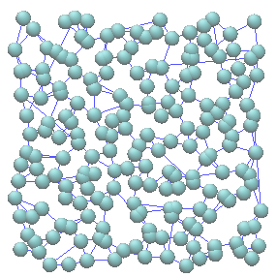
Square Lattice-Random Positions: Comparison
Best Solutions
Simulated Annealing
Ant Colony Optimization
Genetic Algorithm
Go With the Winner
 | Simulated Annealing | Ant Colony Optimization | Genetic Algorithm | Go With the Winner
Avg Energy | 2999.99 | 463.1 | 672.762708 | 2708.94068
Best Energy | 2999.99 | 463.1 | 612.181165 | 2571.18136
Avg Run Time (s) | 821 | 715 | 187 | 1435
Avg Iterations | 800000 | 5101 | 4200 | 400000

Slide 31
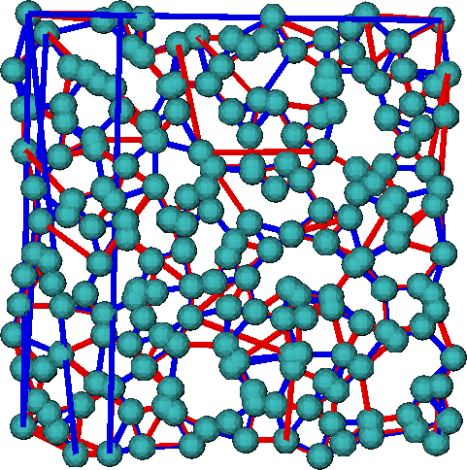
Comparison Between Solutions
Square Lattice - Random Positions
ACO
GA
Connections
634 similar
270 unique
138 : 132 Left v/s Right

Slide 32
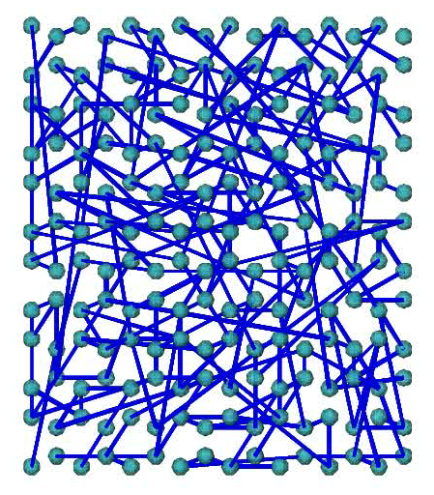
Sample Simulation – ACO with Honeycomb

Slide 33
Conclusion
ACO outperforms other algorithms in all test cases
GA generates multiple solutions – search space exploration
SA is not very efficient for this problem
GWTWs accelerates convergence of SA methods; also yields lower energy solutions
Choice of move is essential for efficient computation
Must highly tune code to run

Slide 34
Thank You

